Slide 1



Consultancy Services for assisting and supporting in Project Management to WBSEDCL for Smart Metering Implementation works under “Revamped Reforms-Linked Results-Based Distribution Sector Scheme” Kick Off Meeting E-Tender No. CE/Comm/Tender/RDSS/Smart Meter/PMA/1397 DTD. 04.04.2023 August’2023
Subtitle, date or author second line

Slide 2
Contents
1
About Deloitte
2
Deloitte’s Approach for Engagement
3
PMC Tool
4
Project Plan & Governance Structure

Slide 3
About Deloitte

Slide 4

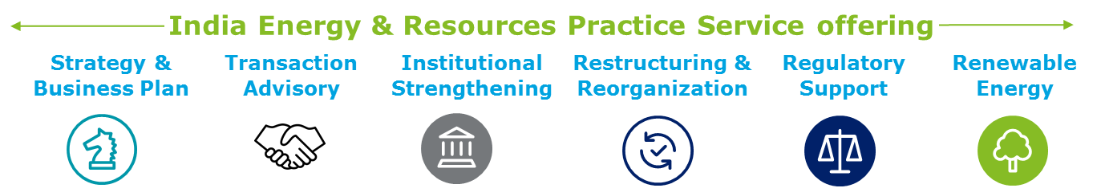
Deloitte brings “best-in-class” capabilities across all aspects of strategy, innovation and market assessment coupled with experience of partnering with some of leading clients across the world
Deloitte is the world's largest professional services firms; our consulting practice has been rated #1 globally by multiple analysts
4,15,000+ professionals
Located in 154+ countries
Deloitte serves 73% of the 95 Fortune Global 500 companies operating in Energy and Resources space
For the fifth consecutive year, industry analysts have maintained their perspective on Deloitte Consulting practices globally.
Globally in Consulting based by Gartner
A worldwide leader in Business Consulting Services based on capability and strategy by IDC MarketScape
#1
Deloitte in India
Our Presence in West Bengal-
With 350+ professional strength and 30+ professionals focusing exclusively in Energy & Resources, Deloitte in Kolkata brings unparalleled experience and exemplary relationships with Government of West Bengal
50,000+ professionals
across 18 locations
120 years of successful client service
Gurgaon
Ahmedabad
Jamshedpur
Baroda
Mumbai
Pune
Kolkata
Goa
Hyderabad
Bengaluru
Chennai
Kochi
Coimbatore
In India, Deloitte serves 36 of 52 BT500 Energy & Resources Companies.
Right combination of global talent and expertise with regional experience and local insights

Slide 5
Our Association with WBSEDCL
Consultancy services for providing assistance to WBSEDCL in all regulatory areas on retainership basis
World Bank Project on Impact Assessment of Energy Transition w.r.t WBSEDCL
EV Accelerator Cell
2015-2019
2019-2020
2020-2021
2021 - Ongoing
2023 - Ongoing
World Bank Project with respect to Financial health Assessment of WBSEDCL
Engagement by WB Dept. of Power. Major assignments/ support given w.r.t WBSEDCL inter alia:
As-is Study of Operations and processes
RDSS Action Plan
Additional Borrowing
Policy draft support

Slide 6
Deloitte’s Approach for Engagement

Slide 7
Task 1: Bid Process Management
Task-1
Key support areas identified
Compliance check with respect to pre-qualification requirements
Detailed assessment of bidder responses and identifying gaps (if any)
Support to WBSEDCL for scoring and evaluation of tender (Technical and Financial)
Support key communication between MoP, WBSEDCL , Evaluation Committee, & Board
Support key communications between WBSEDCL and Bidders for issuance of clarification lettes
EVALUATION MATRIX
Support WBSEDCL in Bid Process Management (except preparation of RFP )
Evaluation of proposals against the evaluation criteria as per the RFP and preparation of bid evaluation reports
Assist WBSEDCL in Award of Contract to the successful bidder(s)
Facilitate in post award activities and institutionalization of the PMO for rollout of smart meters
General Requirements
Technical Requirements
Financial Requirements
Description
Compliance with documentation as mentioned in the RFP
Evaluate the qualifying requirements of sole/lead bidder of JV along with solution/ component providers
If the lead bidder and all consortium members meet the minimum net worth criteria
Criteria
Bid Security/EMD
Registration Certificate
GST Certificate
PAN and PF Details
Memorandum and Articles of Association
Integration of HES with MDM(20000 consumers)
Manufacture and supply (100000 smart meters/ 2000000 static meters)
HES integration with 2 different MDM
MDM integration with 2 different HES
RF implementation with 50000 modules
Minimum net worth of INR 663 Crores in the last three financial years
The AMI-PMA shall use their experience in executing similar bid process management works in other states and the expertise of Subject Matter Experts (SME) to ensure delivery excellence

Slide 8
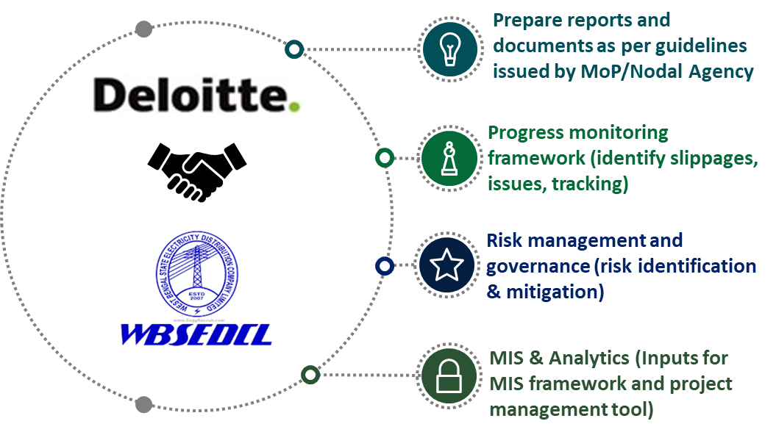
Task 2: Project Management (1/2)
Task-2
Deloitte’s Project Management Office (PMO) shall help to maintain control while executing large capital project such as smart metering under RDSS through a holistic framework enabled by technology, process & people alignment
Deloitte’s PMO Framework
Technology
Project Management of the implementation of smart metering infrastructure
Assist WBSEDCL in pre-implementation activities
Supervision of onboarding of AMISP and setting up of PMO
Supervision of implementation and integration activities
Support in preparation of MIS reports and detailed project documentation
Handholding support to WBSEDCL officials
PMO
People
Process
Integrated Project Monitoring and Control
PROJECT SCHEDULES & CHARTS
PMO ENABLERS
Integrated project management
Risk and Change Management
Schedule Analytics
Web Based Dashboard
Integrated MIS reports
Maintaining timelines
Coordination & MIS Support
The project management platform shall help WBSEDCL in monitoring Smart Meter implementation under RDSS in a very efficient manner ensuring transparency and seamless flow of data across several levels of the organization

Slide 9
Task 2: Project Management (2/2)
Deliverables
Activities
Quality Assurance
Coordination
Maintaining MIS
Conduct site supervision to ensure adherence to specifications as per RFP and flagging any deviations
Coordinate between WBSEDCL field officials, personnel from AMISP and WBSEDCL top management for execution of the project
Develop and maintain MIS reports shall help in timely assessment of bottlenecks and identification of remedial measures
Project Management of rollout of smart meters under RDSS Scheme and integration with HES and MDMS
Detailed project documentation and handholding
Implementation of a cloud based project management tool
System Integration Tests (SIT) and User Acceptance Testing (UAT)
Project documentation including bid evaluation reports, project monitoring reports and reports as required by MoP/other nodal agencies
Deploy a cloud based digital Project Management Tool to monitor the rollout and operational status of smart meters
Support WBSEDCL in System Integration Tests (SIT) and User Acceptance Testing (UAT)
Setting up of AMI-PMA Cell
Finalizing data & information collection plan
Setting up Review & Monitoring Mechanism
Identification and mitigation of risks
Deployment of Project Management Tool

Slide 10
PMC Tool

Slide 11
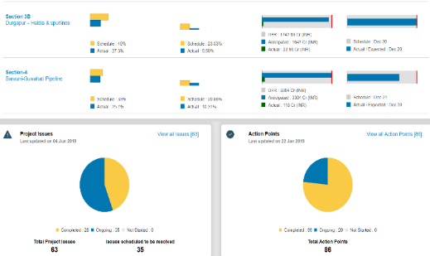
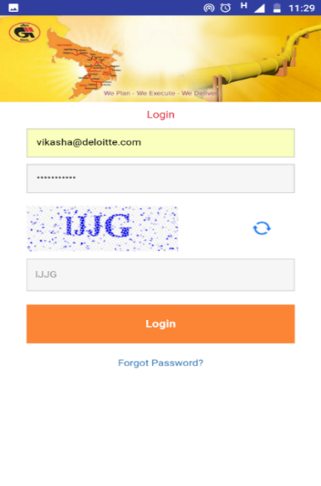
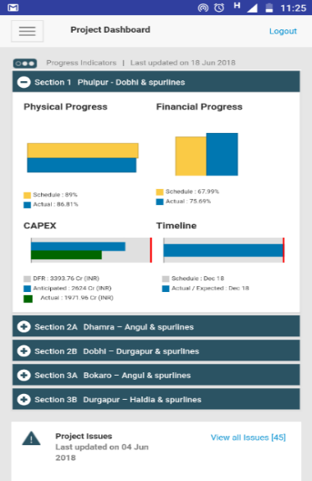
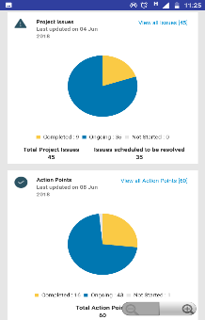
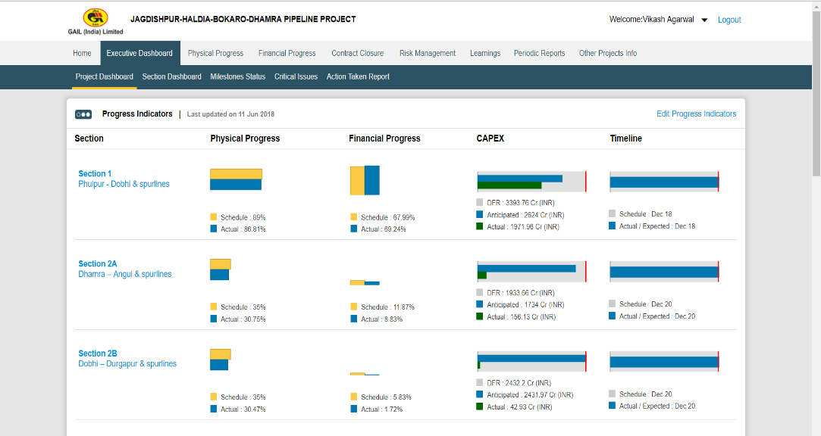
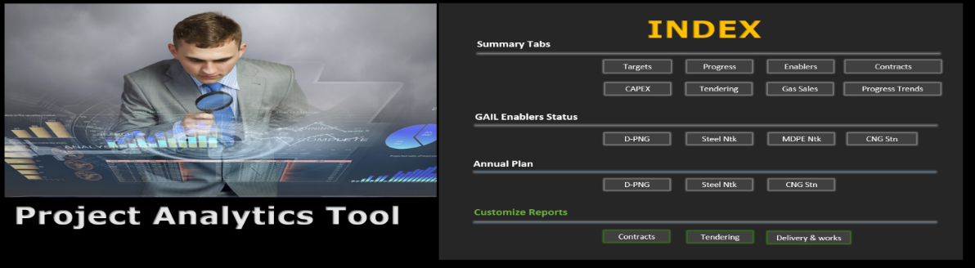
Glimpses*: Project Management Tool....1/5
Web based monitoring platform
Mobile based monitoring platform
ILLUSTRATIVE
BI Platform
*User interface is indicative and will be customized to WBSEDCL preferences based on requirement gathered in first month of Project

Slide 12
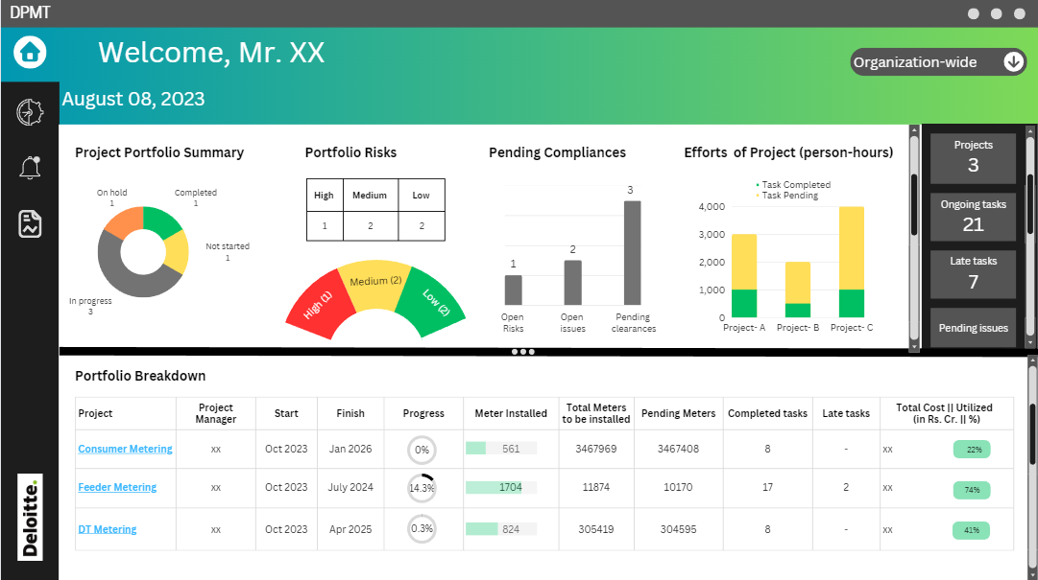
Glimpses*: Project Management Tool....2/5
ILLUSTRATIVE
*User interface is indicative and will be customized to WBSEDCL preferences based on requirement gathered in first month of Project

Slide 13
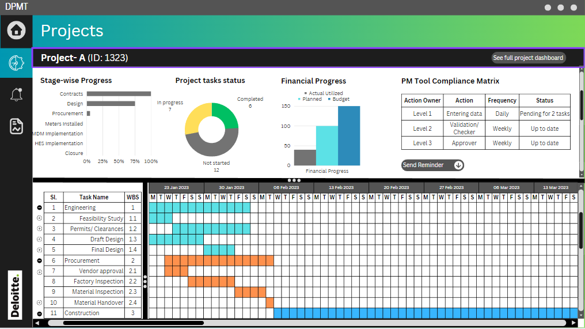
Glimpses*: Project Management Tool....3/5
ILLUSTRATIVE
*User interface is indicative and will be customized to WBSEDCL preferences based on requirement gathered in first month of Project

Slide 14
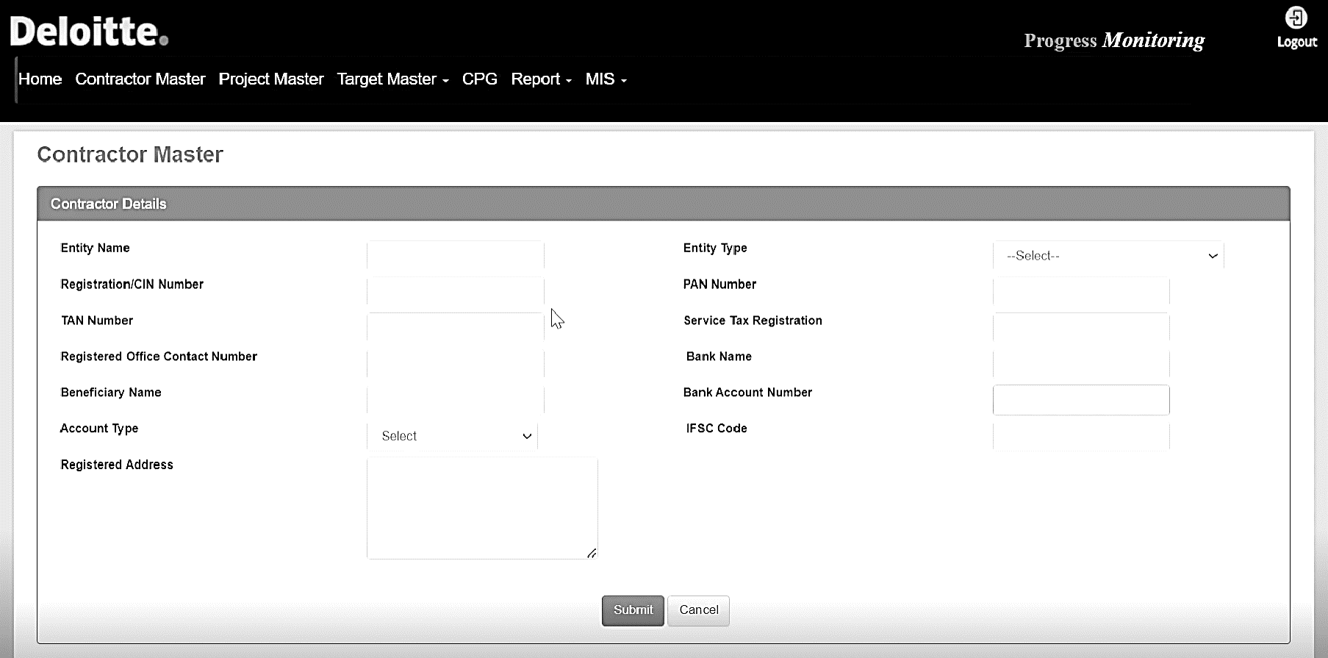
Glimpses*: Project Management Tool....4/5
ILLUSTRATIVE
Contractor Master
*User interface is indicative and will be customized to WBSEDCL preferences based on requirement gathered in first month of Project

Slide 15
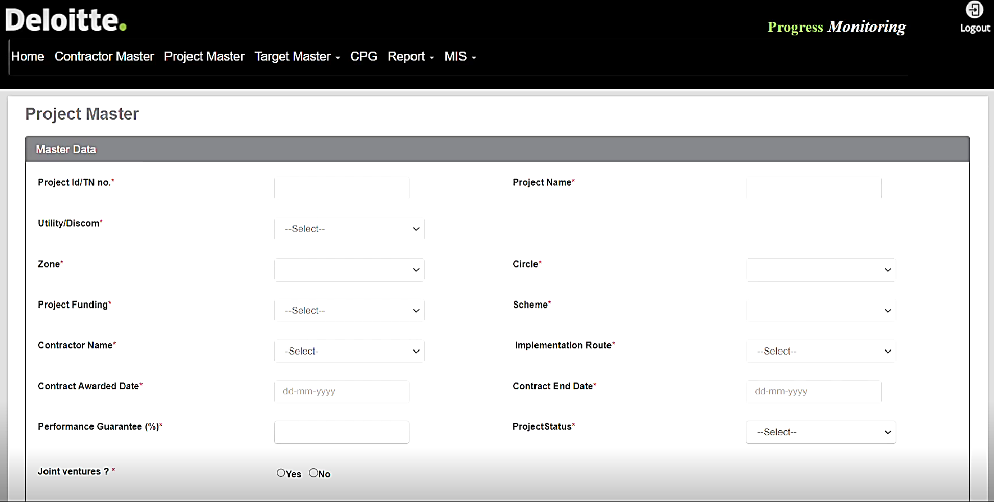

Glimpses*: Project Management Tool....5/5
ILLUSTRATIVE
Project Master
*User interface is indicative and will be customized to WBSEDCL preferences based on requirement gathered in first month of Project

Slide 16
Project Plan & Governance Structure

Slide 17
Project Work plan
We are
here today
AMISP Contract
Award
Months
Key Activities | 1 | 2 | 3 | 4 | 5 | 6 | 7 | 8 | 9 | 10 | 11 | 12 | 13 | 14 | 15 | 16 | 17 | 18 | 19 | 20 | 21 | 22 | 23 | 24 | 25 | 26 | 27 | 28 | 29 | 30 | 31 | 32 | 33 | 34 | 35 | 36
Kick off and Bid Evaluation Support
Kickoff meeting and stakeholder alignment
AMISP Technical Bid Evaluation Support
AMISP Financial Bid Evaluation Support
Submission of Final Bid Evaluation Report
Project Management
Tech specification finalization (If reqd.)
Quality Assurance assessment
Coordination with stakeholders for Supply Chain monitoring
Identification of possible Bottlenecks
Preparation of Remedial Action Plan
Coordination and reporting to various stakeholders
Fund flow management support
Implementation of cloud-based monitoring tool for SM monitoring
Project Supervision functions
Support in System Integration Tests (SIT) and User Acceptance Testing (UAT)
Preparation and follow-up of deficiency lists for contractors
Conducting site supervision to countercheck project quality
MIS, Progress Reports
Note: Further scope for furnishing Quarterly reports or any others report as per the scheme Guidelines and instructions that may be issued by the Ministry of Power/Nodal Agency from time to time and based on the data/inputs to be provided by the DISCOM
The above time line is dependent on suceesful award and onboarding of AMISP
Activity performed on Need Basis
Daily Activity
Deliverable

Slide 18



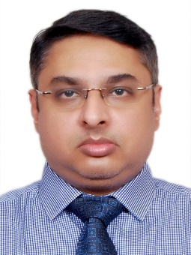
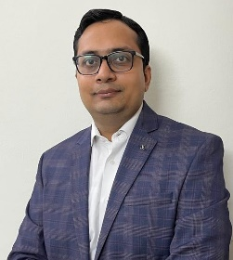
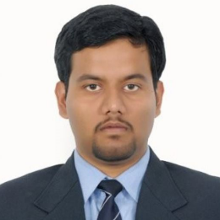
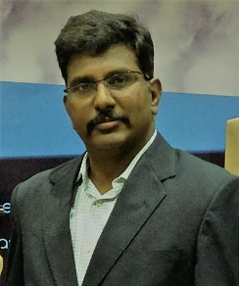
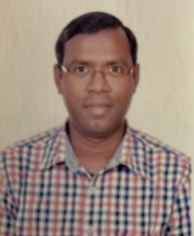
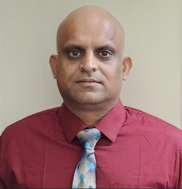
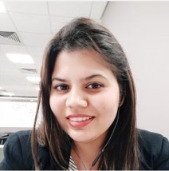
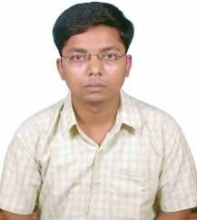
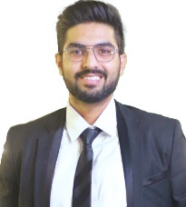
Project Governance Structure
WBSEDCL management personnel
Steering committee
To be Defined
WBSEDCL
Anujesh Dwivedi
Engagement Partner
Samrat Roy
Director
Project Management
WBSEDCL Project Manager
Sayan Mitra
Team Leader
To be Defined
WBSEDCL
Project Management and operating team
WBSEDCL professionals
Varun Singhal
Smart Meter Expert
Aritra Roy
System Integration Expert
Vijay Kumar K
MDMS Expert
Vinay Choudhary
HES Expert
Representatives from WBSEDCL
Communication
IT
Access to pool of consultants (need basis)
Commercial
Finance/Admin
Saurabh Bhushan
Cloud Infrastructure Expert
Harshita Malhotra
Cyber Security Expert
Sujoy Das
Field Engineer
Piyush Sharma
Field Supervisor
Provide inputs as well as coordinates leadership interactions as needed to understand constraints, capabilities & capacities

Slide 19
Assistance we require from BPDB
WBSEDCL is requested to appoint a single point of contact (SPOC) for the engagement. This SPOC will be responsible for coordination activities including setting up discussion sessions with WBSEDCL Leadership team on need basis
WBSEDCL is requested to share information requested by Deloitte team will be provided within 48 hours and will be of sufficient standard of quality, accuracy and completeness.
Facilitate meetings with WBSEDCL Leadership and external stakeholders as and when requested by Deloitte Team
Stakeholder availability to attend workshops, providing relevant inputs, approvals and sign-offs at key milestones is a critical dependency to overall project delivery. Lack of availability or lack of decision making by key mandated stakeholders may impact the overall engagement delivery, timelines and costs. These impacts will be proactively highlighted and managed as part of the project management activities
Deloitte will not take any management decision on behalf of WBSEDCL

Slide 20
Deloitte refers to one or more of Deloitte Touche Tohmatsu Limited (“DTTL”), its global network of member firms, and their related entities (collectively, the “Deloitte organization”). DTTL (also referred to as “Deloitte Global”) and each of its member firms and related entities are legally separate and independent entities, which cannot obligate or bind each other in respect of third parties. DTTL and each DTTL member firm and related entity is liable only for its own acts and omissions, and not those of each other. DTTL does not provide services to clients. Please see www.deloitte.com/about to learn more.
© 2023. For information, contact Deloitte Touche Tohmatsu Limited.

Slide 21
Appendix

Slide 22

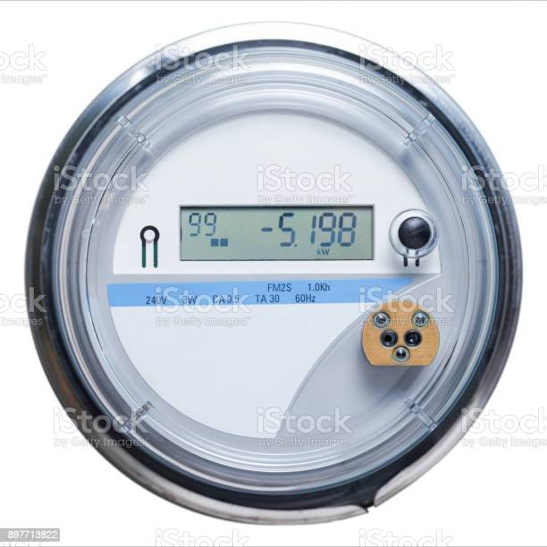

Reference Smart Meter Architecture
Zone 1
Zone 3
Zone 4
Zone 5
Zone 2
Zone 3
Zone 2
Dis-comm and Legacy systems
Smart Meter Network
Pictures
Head end system
Billing systems
GPRS Connectivity
RF Mesh
PLC
Mobile applications
Connectivity
API
API
API
Web Self service (consumer portal)
Middleware
MDM
Middleware
CRM and meter data syncs
Web services
Web services
Web services
ERP
Unauthorized meter authentications
Malicious Firmware Update
Insecure Firmware update transfers
No integrity checks on firmware files
Meter tampering and cyber physical attacks
Meter memory DDOS attacks
Connectivity issues
Meter Coning
SIM Cloning
Remote Connectivity
Unauthorized Bulk Commands, remote connect and disconnect
No MPLS Firewall
Errors in manual batch processing of smart meter files
Insecure API’s
No integrity checks on meter data files
Insecure smart meter gateways and integrations
Privacy threats for consumer sensitive data
Unauthorized consumer energy consumption pattern analysis.
Unencrypted network
Dependencies on Discoms for CRM data.
APT threats from mobile system.
Modifications in billing process data.
Sensors and Actuators
IP Communication
Supervisory and control systems
Operations Management
CRM

